Slide 1
Can long-term memory help a small model build better websites?
Group meeting · WebGen-Bench
Text lessons vs code examples
Qiaopan Ma · Supervisor: Qian Liu · 16 October 2026
Notes:
Good morning, everyone. I am Qiaopan. My topic : can long-term memory help a small model build better websites, and should that memory be text or code?

Slide 2
A 7B model builds 101 websites, one after another
The task and the question
Benchmark
Long-term memory
WebGen-Bench: 101 website requests from 20 areas. A GUI agent clicks through each site and checks the features.
After each task, the system writes down what went wrong. Later tasks can reuse it.
Question: does the model get better as it gains experience?
Notes:
A 7B model builds 101 websites, one after another, on WebGen-Bench. A GUI agent tests each site. With long-term memory, the system writes down what went wrong after each task, and later tasks reuse it. Does the model get better with experience?

Slide 3



The official pipeline, and what Long Memory adds
The big picture
WebGen-Bench baseline (No Memory)
Website request
Generator
Testers
Score
text from the user
Bolt agent + WebGen-LM-7B
WebVoyager + Qwen2.5-VL-32B; screenshot grader
pass / partial / fail
Before the next task: add a checklist and code examples
After each task: reflect on the test, find code errors, save short fixes
Memory bank
Qwen2.5-VL-72B + bge-m3
Same generator, same tester, same rules. Long Memory (blue) only changes the text the generator reads.
Notes:
The top row is the official pipeline: request, generator, testers, score. Our memory, in blue, reflects after each task and adds a checklist and code examples before the next one. Everything else stays the same.

Slide 4
Official rules, and our baseline matches the paper
Setup
# | Step | Agent / tool | Model (LLM)
1 | Build website | Bolt agent (coding) | WebGen-LM-7B, one try, no repair
2 | Test features | WebVoyager (GUI agent) | Qwen2.5-VL-32B
3 | Grade appearance | Screenshot grader (one call) | Qwen2.5-VL-32B (paper: GPT-4o)
4 | Write and pick memory | Our Long Memory module | Qwen2.5-VL-72B-AWQ + bge-m3 embedding
Score = (pass + 0.5 × partial) / checks · No Memory baseline 28.5% (paper: 28.4%)
Check results: pass = the feature works; partial = it works only in part (counts 0.5); fail = 0. Accuracy is summed over all 647 checks.
Notes:
All models run on our own cluster. The generator gets one try with no repair. Accuracy counts pass as one and partial as half. Our No Memory baseline gives 28.5 percent; the paper reports 28.4, so the pipeline is faithful.

Slide 5
A small model trained for this tool, on two H200 GPUs
Models and compute
WebGen-LM-7B (the generator)
Hardware: 2 × NVIDIA H200 (141 GB each)
• Built by the WebGen-Bench authors
• Base: Qwen2.5-Coder-7B-Instruct
• Fine-tuning only (SFT), no RL
• Data: DeepSeek-V3 built sites in Bolt for 2,000 requests; kept the 600 best (look ≥ 3/5)
• So it already knows Bolt’s output format
• Paper baseline: 28.4%
• GPU 0: 32B tester (83 GB) + 7B generator (26 GB)
• GPU 1: 72B memory model (113 GB) + bge-m3 (2 GB)
• All self-hosted with vLLM; no paid API
• Two tasks in parallel, about 12 min each
• About 470 GPU-hours since 5 Oct
• All runs finished in about 2 weeks
Notes:
The generator is WebGen-LM-7B: Qwen2.5-Coder-7B fine-tuned by the benchmark authors on Bolt trajectories, so it already knows Bolt's format. Everything is self-hosted on two H200 GPUs on the school cluster, with no paid API. One task takes about twelve minutes with memory.

Slide 6
What we compare, and in which task orders
Experiments
Arm | Question it answers | Task orders
No Memory | Baseline: does it match the paper (28.4%)? | Original, grouped, random
Text memory | Do written lessons help? | Original
Checklist only | Does splitting the request into a list help? | Original
Code memory (whole-file) | Do code examples help? | Original, grouped, random
Code memory (fragments), final | Does the final method hold in other orders? | Original, grouped, random (seed 47: running)
Fixed code prefix | Is it learning, or just code in the prompt? | Original (queued after seed 47)
Task order | How the 101 tasks are arranged
Original | The benchmark list: tasks of the same domain (e.g. all e-commerce sites) come one after another
Shuffled, domains grouped | Domains in a random order, but each domain’s tasks still stay together
Fully random | All 101 tasks shuffled, so domains are mixed
Alternating (running) | Every next task comes from a different domain
Notes:
This table shows what we compare, and in which task orders. Every run builds all 101 websites from an empty memory. Seed 47 is still running.

Slide 7
Text lessons helped early, then fell below the baseline
First attempt: text lessons
Tasks | No Memory | Text memory
Tasks 1–30 | 26.0% | 39.3%
Tasks 61–101 | 24.8% | 22.9%
Over time, more and more vague advice filled the prompt, such as "make sure the form works". The small model could not act on it.
Each number is the accuracy on that group of tasks, in execution order. Tasks 31–60 are left out to show the start and the end clearly.
Notes:
Our first attempt, text memory, used text lessons. They helped on the first 30 tasks, but by the end text memory fell below No Memory, because vague advice filled the prompt and the small model could not act on it.

Slide 8


One missing package turns the whole site into an error page
What the tester sees · task 000006, a solar dashboard
No Memory: imports vue-chartjs, which is not installed → score 0
Code memory (fragments): three working views → score 1.0
Notes:
Same task, a solar dashboard. Without memory, the model imports a chart library that is not installed, so the page shows only an error and every test fails. This is the most common way the 7B model scores zero. With memory, the prompt carried a short working code example, and every test passed.

Slide 9
The small model follows code, not text
Key finding
1 / 3
7 / 9
blank-page sites fixed by a text tip
fixed by a 10-line code example
Blank page: the site imports a package that is not installed (for example vue-router), so nothing is shown. Test: generate only, same prompts, check the code.
Notes:
This led to our key finding. Many sites were blank because they used a package that was not installed. A text tip fixed one in three. A ten-line code example fixed seven in nine. The small model follows code, not text.

Slide 10
Two parts: a checklist and a code pool
Method · code memory
1. Requirement checklist
2. Code pool
The memory model splits the request into a list. Each lesson sits under the item it belongs to. The request always comes first.
When a code error appears in 2 tasks, take a short fix from our own earlier site that worked. At most 15 lines, checked by a compiler.
Example: import { ref } from 'vue' · const bookingId = ref('')
Notes:
So whole-file code memory has two parts. A checklist that splits the request, and a code pool: when an error appears in two tasks, we take a short working fragment from our own earlier sites, checked by a compiler.

Slide 11
Text memory → code memory (whole-file) → code memory (fragments)
Three memory designs
Design | What memory gives the model | Why we moved on | Result (101 tasks)
Text memory | Checklist + text lessons | Vague text piles up; the 7B model ignores it | 30.9%; below NM after task 30
Code memory (whole-file) | Checklist + code copied from our earlier working sites; some examples are a whole file (full App.vue) | Whole-file examples caused blank sites in new orders | 40.0%, +11.5
Code memory (fragments) | Same, but each example is only the few key lines (at most 15), never a whole file | Original order: below whole-file; kept for robustness across orders | 35.2%, +7.1; grouped +7.4; random +5.5
Ablation: checklist only | Checklist, memory turned off | — | 31.8% (+3.4, CI includes 0)
NM = No Memory (28.5%). Repository labels: v4, v7, v9.1.
Notes:
Three families. Text memory: lessons as text, 30.9 percent. Code memory with whole files: 40 percent. The final version uses only fragments: 35.2 percent in the original order, lower, but it removed the blank sites when the order changed, so we keep it.

Slide 12
Accuracy rises from 28.5% to 35–40%
Main result · 101 tasks, one run
No Memory
Code memory (whole-file)
28.5%
40.0%
30 zero-score tasks
13 zero-score tasks
Whole-file: +11.5 points (95% CI 6.0 to 16.9). Fragments (final method): 35.2%, +7.1 (0.9 to 13.1), 20 zero-score tasks.
Zero-score task: every check fails, usually a blank page. 95% CI: the likely range of the gain, from resampling tasks; it does not include 0.
Notes:
Without memory: 28.5 percent. Whole-file code memory: 40 percent, plus 11.5 points, interval excludes zero. The final fragment version: 35.2 percent, plus 7.1, interval also excludes zero.

Slide 13
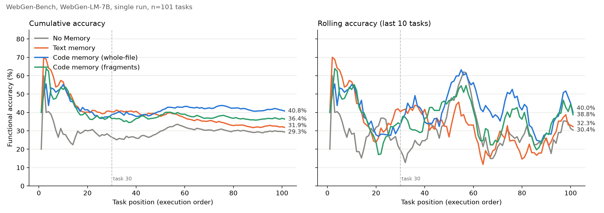
Only the code-pool version keeps its lead
Learning curve · 101 tasks, execution order
Left: cumulative = average of all tasks so far. Right: rolling = average of the last 10 tasks, so it shows short-term ups and downs. Dotted line: task 30.
Notes:
The learning curve. Text memory, orange, falls below No Memory. Both code memories, blue and green, stay above it to the end.

Slide 14
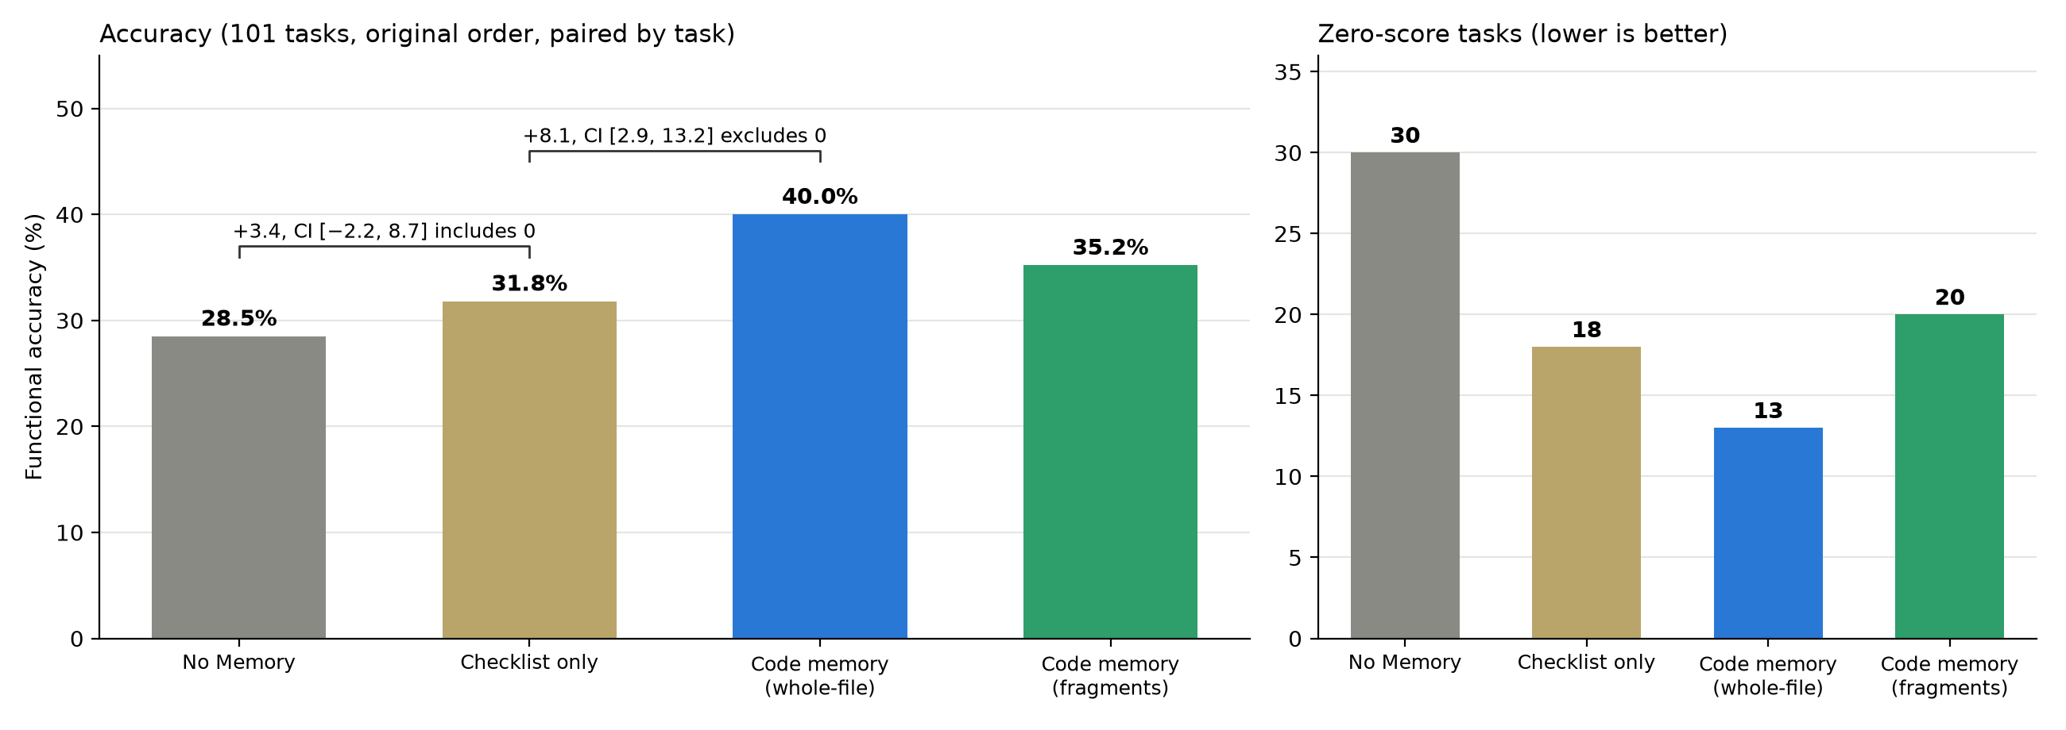
Memory, not the checklist, drives the gain
Ablation study · checklist vs. memory
Zero-score tasks: sites where every check fails.
Takeaways
Checklist alone: +3.4 points, CI includes 0; mainly fewer blank sites.
Memory on top of the checklist: +8.1 points (95% CI 2.9 to 13.2).
So most of the gain comes from memory, not from splitting the request.
Notes:
The ablation adds one part at a time. The checklist alone adds 3.4 points, and its interval includes zero. Adding memory on top adds 8.1 points, and its interval excludes zero. So most of the gain comes from memory.

Slide 15
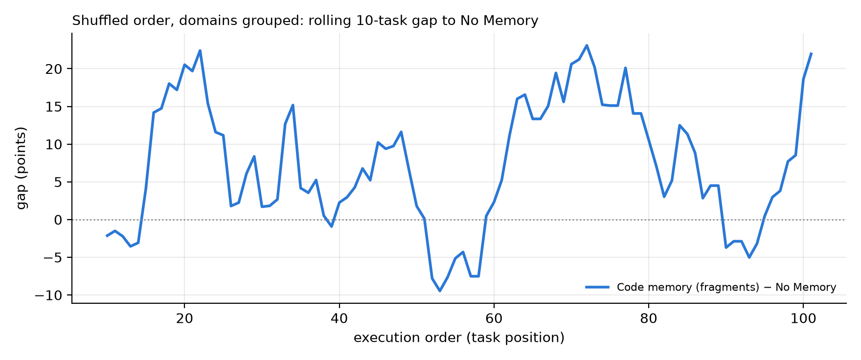
Whole-file examples caused blank sites; fragments fixed it
Task order · two new orders
Task order | Version | Code example in memory | Blank scaffolds
Shuffled, domains grouped | Code memory (whole-file) | Whole App.vue file | 19
Shuffled, domains grouped | Code memory (fragments) | Checked fragment | 0
Fully random | Code memory (whole-file) | Whole App.vue file | 16
Fully random | Code memory (fragments) | Checked fragment | 0
What it means
With whole-file examples, the model copied a whole file as a finished answer and returned the empty starter project.
With fragments: zero blank sites in both orders. In the original order they stopped vue-router less reliably (35.2% vs 40.0%).
Chart: fragments version minus No Memory, averaged over the last 10 tasks; above 0 = memory scores higher.
Notes:
In new orders, whole files were copied as finished answers, giving blank sites; fragments removed them. In the original order, fragments stopped vue-router less well. Neither form wins in every order.

Slide 16
What we still need to check
Limits and next steps
Limits
Next steps
One run per task order (the paper also uses one run)
Gain is in features, not in look (3.25 vs 3.22)
One model and one tool (Bolt + Vue)
Method tuned on the same 101 tasks; original order: fragments 35.2% vs whole-file 40.0%
Seed 47 and alternating orders: about 17–18 Oct
Fixed code prefix: after seed 47
Thesis draft to supervisor: 19 Oct
Notes:
Some limits: one run per order, gains in features not look, one model and tool, method developed on this benchmark. Next: seed 47, the alternating order and the fixed-code control.

Slide 17
References
Lu et al., 2025. WebGen-Bench: Evaluating LLMs on generating interactive and functional websites from scratch. arXiv:2505.03733.
He et al., 2024. WebVoyager: Building an end-to-end web agent with large multimodal models. ACL.
StackBlitz Labs, 2024. bolt.diy: open-source AI coding agent. github.com/stackblitz-labs/bolt.diy.
Zhao et al., 2024. ExpeL: LLM agents are experiential learners. AAAI.
Ouyang et al., 2026. ReasoningBank: Scaling agent self-evolving with reasoning memory. ICLR. arXiv:2509.25140.
Chhikara et al., 2025. Mem0: Building production-ready AI agents with scalable long-term memory. arXiv:2504.19413.
Wang, Mao, Fried & Neubig, 2025. Agent Workflow Memory. ICML. arXiv:2409.07429.
Zheng et al., 2024. Synapse: Trajectory-as-exemplar prompting with memory. ICLR. arXiv:2306.07863.
Wang et al., 2023. Voyager: An open-ended embodied agent with large language models. arXiv:2305.16291.
Suzgun et al., 2026. Dynamic Cheatsheet: Test-time learning with adaptive memory. EACL. arXiv:2504.07952.
Zhang et al., 2026. Agentic Context Engineering: Evolving contexts for self-improving language models. ICLR. arXiv:2510.04618.
Dai et al., 2026. Metis: Bridging text and code memory for self-evolving agents. arXiv:2606.24151.
Kim et al., 2026. Memory Transfer Learning: How memories are transferred across domains in coding agents. arXiv:2604.14004.
Shi et al., 2023. LLMs can be easily distracted by irrelevant context. ICML.
Liu et al., 2024. Lost in the middle: How language models use long contexts. TACL 12.
Du et al., 2025. Context length alone hurts LLM performance despite perfect retrieval. Findings of EMNLP. arXiv:2510.05381.
Madaan et al., 2023. Self-Refine: Iterative refinement with self-feedback. NeurIPS.
Notes:
These are our main references.

Slide 18
For a small model, memory should give code, not advice
28.5% → 35–40% · most of the gain comes from memory
Thank you. Questions? · Code and data: github.com/qiaopan/WebGen-Bench
Notes:
For a small model, memory should give code, not advice. Accuracy rises from 28.5 to 35 to 40 percent, mostly from memory. Thank you.

